Slide 1
Exploratory Data Analysis and Visualization of New York City Airbnb Listings – 02/11/21
Kapil Pundhir, Hillary Mandich, Cecilia Leung, Amaris Hassan, Caitlan Beachey

Slide 2


Introduction
Airbnb has over 7 million listings and over 2.9 million hosts worldwide in 2021.
With accessibility in over 100, 000 cities, the United States alone holds the highest number of listings of any country in the world.
New York City (NYC) is one of the most visited tourist attractions globally, a major center of the entertainment industry, and the world’s leading financial center.
With these factors in consideration, it comes as no surprise that NYC is also one of the top three most popular cities used on Airbnb.
Notes:
In-depth analysis on one of the most densely populated cities in the world.

Slide 3
Exploratory Questions
What are the different types of properties in NYC?
Does property type availability vary by neighbourhood?
What neighbourhoods in NYC are rated highly by guests?
How do prices of listings vary by location?
How has the demand for Airbnb rentals evolved between **date?
Notes:
The aim of our project’s analysis is to answer the following questions:
What are the different types of properties in NYC?
Does property type availability vary by neighbourhood?
What neighbourhoods in NYC are rated highly by guests?
How do prices of listings vary by location?
How has the demand for Airbnb rentals evolved from ** date?

Slide 4
Analysis of Data Quality
Data Sourced from Inside Airbnb (http://insideairbnb.com/get-the-data.html ) which hosts publicly available data from the Airbnb site.
Detailed listings data provided 36924 records from **Date**.
Data comprised of 64 attributes covering listing amenities, listing availability, neighbourhood, host background, and reviews for each record.
Notes:
-The data is sourced from the Inside Airbnb website http://insideairbnb.com/get-the-data.html which hosts publicly available data from the Airbnb site.
-Columns/features we were interested in did not contain data in the required format and hence were manipulated in a way that their meanings are retained.

Slide 5
Analysis of Data Quality
price : The price column contained data in string format with the currency symbol ‘$’ and comma separator
rating(listings) : There are several ratings that hosts receive including ‘location rating’, ‘cleanliness rating’ and ‘overall rating’.
availability
host_is_superhost, host_identity_verified, instant_bookable: Contained string format of ‘t’ and ‘f’
Notes:
r

Slide 6
Data Munging Techniques
Values in columns comprised of percentages, integers, and var char string. Data were standardized and transformed to a similar scale.
Notes:
-The data is sourced from the Inside Airbnb website http://insideairbnb.com/get-the-data.html which hosts publicly available data from the Airbnb site.
-Columns/features we were interested in did not contain data in the required format and hence were manipulated in a way that their meanings are retained.
Ratings techinque – used Super Host and Number of Reviews.

Slide 7
Final Dataset
***listing attributes
id
name
host_id
neighbourhood
neighbourhood_group
latitude
longitude room_type
price
minimum_nights
number_of_reviews
last_review
reviews_per_month
calculated_host_listings
availability_365
Notes:
-(Give brief overview of columns/rows we began with → Final result of Listings Cleaned)
*Include screenshot

Slide 8
Relationship of Datasets
Notes:
*** Include screen shot of ERD Diagram

Slide 9
Relationship of Datasets
Notes:
*** Provide details on Elephant SQLscreenshots/ queries.

Slide 10
Coding Approach
Notes:
*** Provide details on Elephant SQLscreenshots/ queries.

Slide 11
Creating Interactive Visualizations

Slide 12
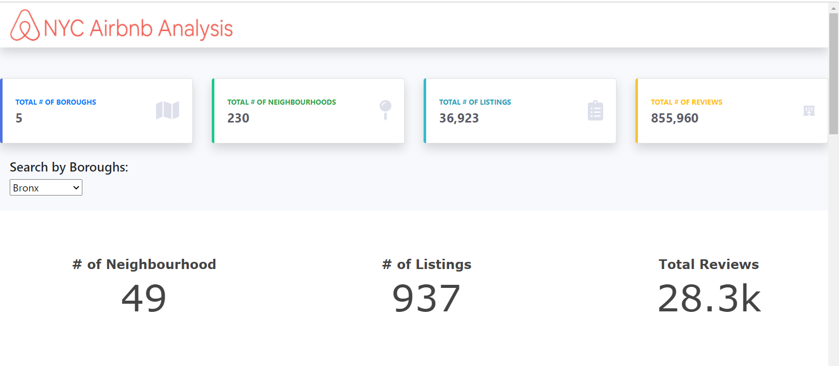
Web Dashboard

Slide 13
Next Steps…

